Slide 1



Worldwide Game Sales
View in Power BI
Last data refresh:
13.01.2023 21:14:51 UTC
Downloaded at:
16.01.2023 10:34:23 UTC

Slide 2
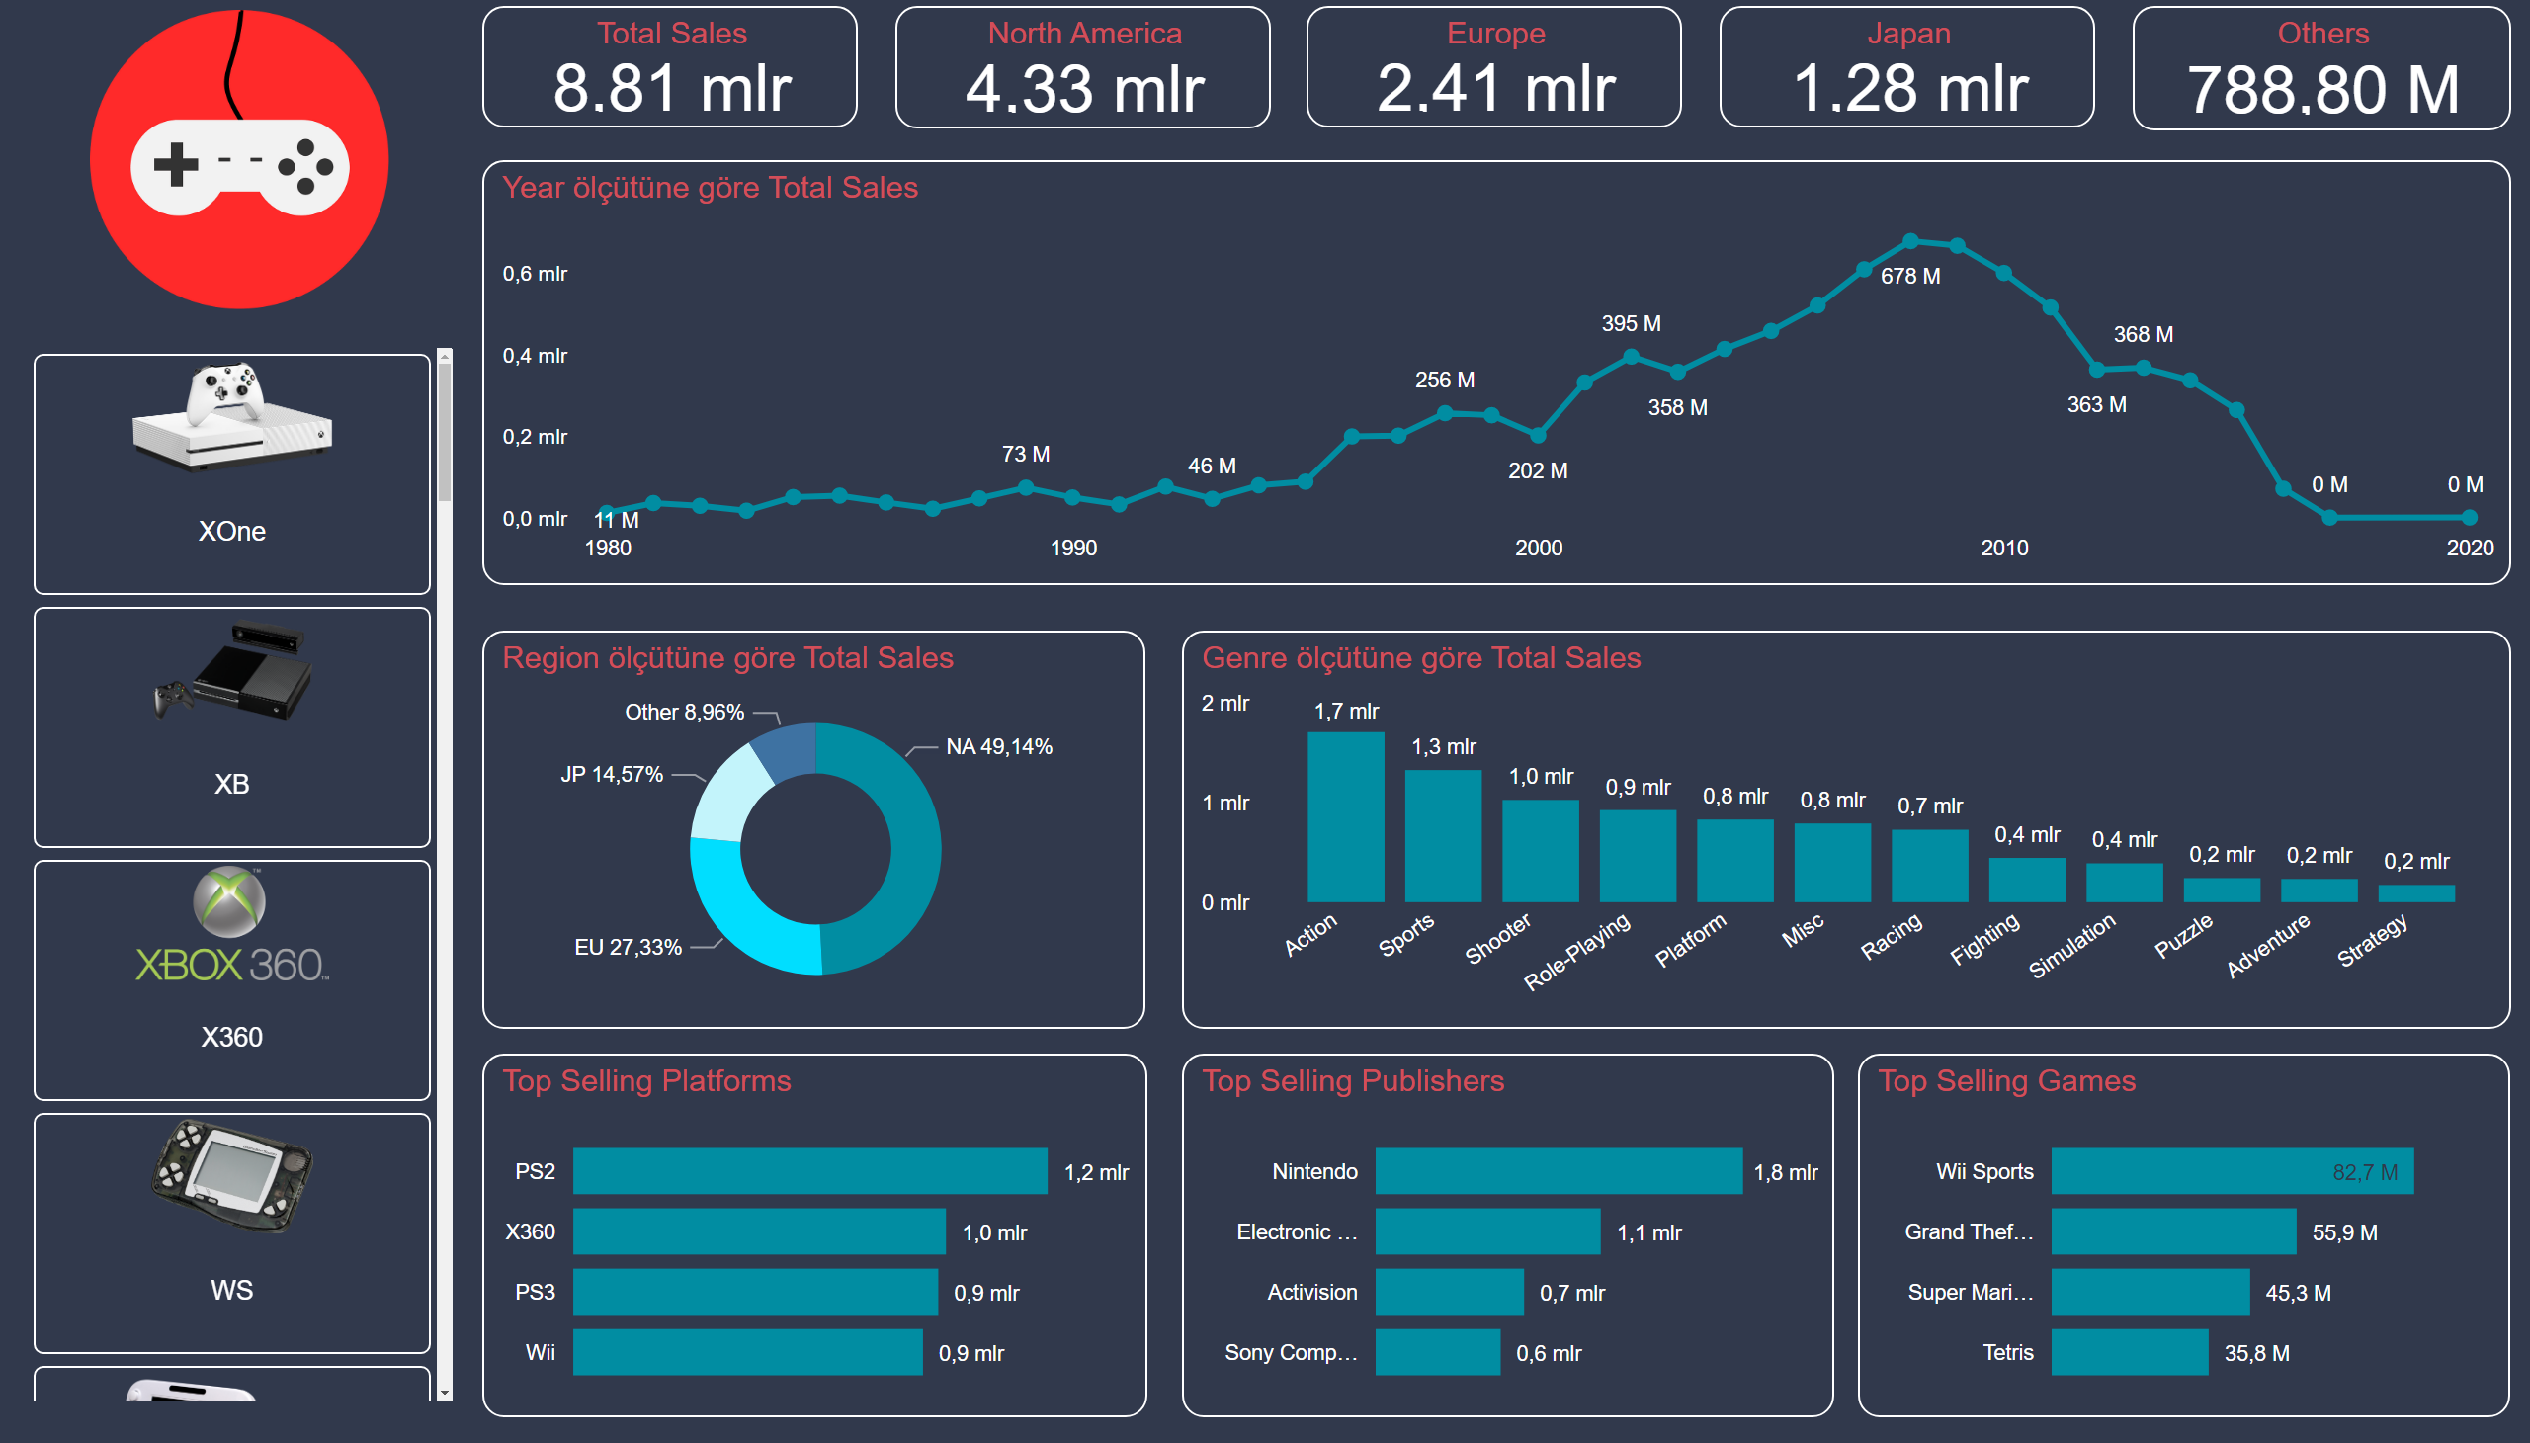
Overview
Notes:
Total Sales
No alt text provided
North America
No alt text provided
Europe
No alt text provided
Japan
No alt text provided
Others
No alt text provided
lineChart
No alt text provided
donutChart
No alt text provided
columnChart
No alt text provided
Top Selling Platforms
No alt text provided
Top Selling Publishers
No alt text provided
Top Selling Games
No alt text provided
image
No alt text provided
ChicletSlicer1448559807354
No alt text provided

Slide 3
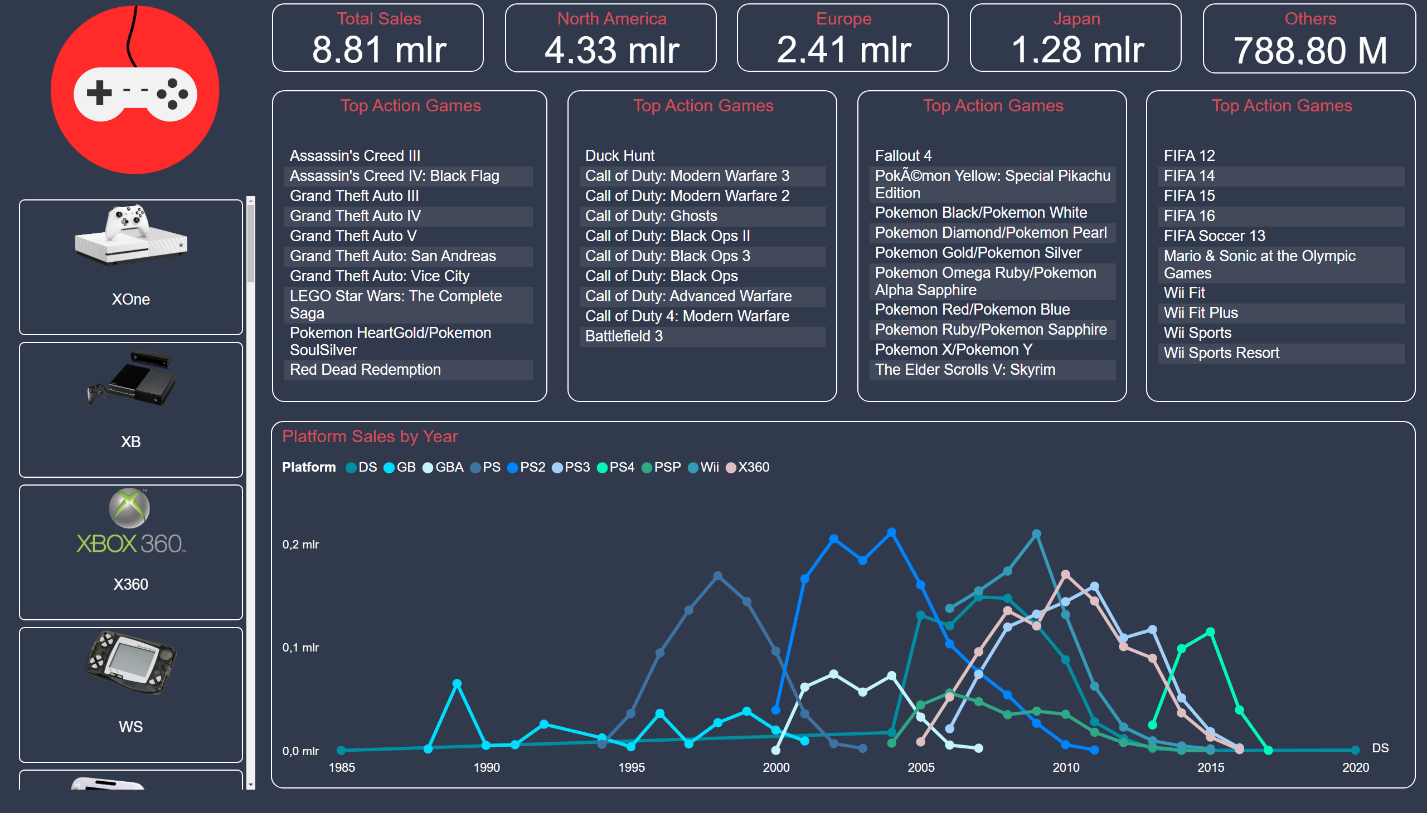
Detailed Analysis
Notes:
Total Sales
No alt text provided
North America
No alt text provided
Europe
No alt text provided
Japan
No alt text provided
Others
No alt text provided
Platform Sales by Year
No alt text provided
image
No alt text provided
Top Action Games
No alt text provided
Top Action Games
No alt text provided
Top Action Games
No alt text provided
Top Action Games
No alt text provided
ChicletSlicer1448559807354
No alt text provided

